Slide 1
Python Programming:
Strings

Slide 2
Introduction to Strings
Strings are collection of characters.
Strings are represented in Python using ‘ ‘ or “ “
Characters are combination of alphabets, digits, special characters and spaces.
Strings represent as text rather than numbers.
Example:
“Hello World!!!”
“My e-mail id is : abc_123@gmail.com”

Slide 3
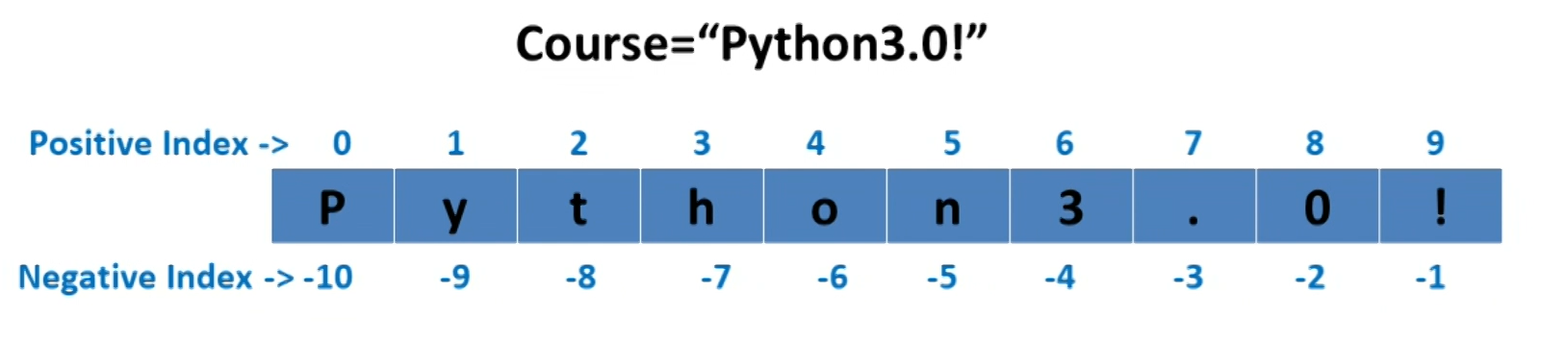
String Indexing
Square brackets used to access the element.
Course[0] - ‘P’
Course[4] – ‘o’
Course[-1] – ‘!’
Course[-6] – ‘o’
Course[15] – Index Error

Slide 4
Strings Operations
Using + Operator (Concatenation):
A1 = ‘Hello’ B1 = ‘World’ C1 = ‘!!!’
D1 = A1 +B1 + C1
print(D1)
Output:
‘HelloWorld!!!”
Using * Operator:
* creates multiple copy of a string.
A1 = ‘Hello’ * 4
print(A1)
Output: ‘HelloHelloHelloHello’

Slide 5
Strings Operations
Using * Operator:
* creates multiple copy of a string.
A1 = ‘Hello’ B1 =3
print(A1*B1)
Output: ‘HelloHelloHello’
It would require positive integer, but amusingly, it can be zero or negative integer as well, in which case the result is …..
String length function:
A1 = ‘Hello World!!!’
print(len(A1))
Output: 14

Slide 6
Strings Handling Functions
A = ‘hello world’
A.capitalize() A.find(‘o’)
Output: ‘Hello world’ Output: 4
A.upper() A.lower()
Output: ‘HELLO WORLD’ Output: ‘hello world’
print(A) print(A)

Slide 7
Strings Handling Functions
A = ‘abc123’
A[4].isdigit() A[2].isalpha()
Output: True Output: True
A.isdigit()
Output: False # Entire string is checked as digit
‘1’ in A ‘123’ in A ‘1234’ in A
Output: True Output: True Output: False

Slide 8
Strings Handling Functions
A = ‘Hello world’
A.count(‘o’) A.replace(‘ld’, ‘dl’)
Output: 2 Output: hello wordl
A.swapcase()
Output: ‘hELLO WORLD’
A.endswith(‘ld’)
Output: True
Difference between ‘in’ and ‘endswith’

Slide 9
String Slicing
Slicing helps to extract a substring from a given string.
Syntax:
String_name[begin:end:step]
No colon, it is indexing
With colon, it is slicing
‘Begin’, ‘end’, and ‘step’ are optional. But, ‘:’ is mandatory.
Begin: Starting index of string
End: Denotes end index of string (not inclusive)
Step: progress steps, by default it is 1 step.

Slide 10
String Slicing
Example:
S is a string
S[1:3] – Starting from index (offset) 1 till index 2
S[1:] – Fetches item from index 1 till the end
S[:3] – Fetches from starting (index 0) till index 2.
S[:-1] – Negative indexing, starts from index 0 upto last but one
S[:] – Fetches everything from index 0 till end

Slide 11
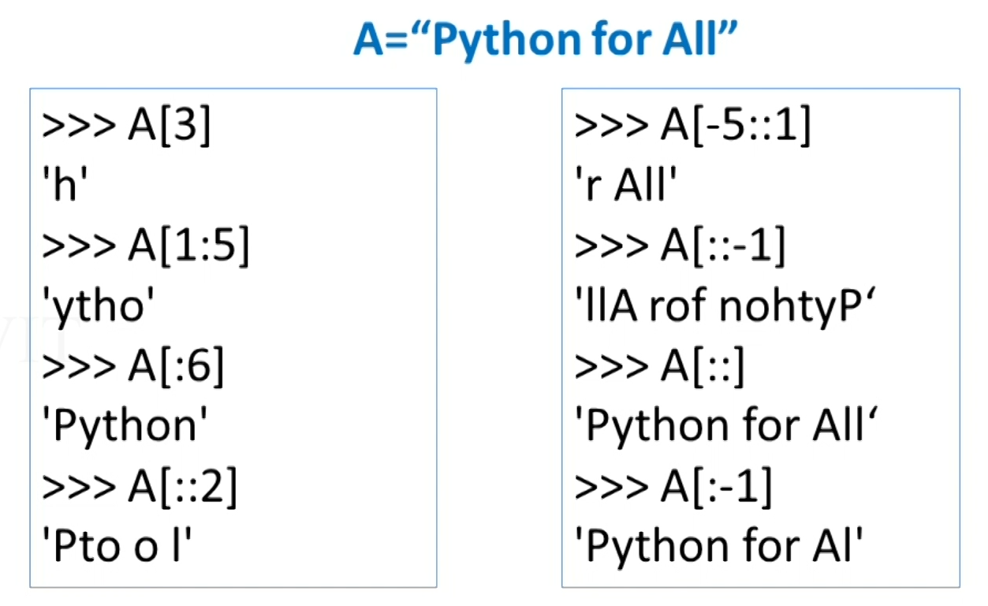
String Slicing

Slide 12
Delete a String
‘del’ function is used to delete a string.
A=‘hello world’
del A
String will be deleted.
print(A)
Output: Error

Slide 13
Converting String into Number
‘42’ + 1
Output: Error
int(‘42’) str(42) # Convert from / to string
42 ‘42’ # Output
int(‘42’) + 1
43 # Output
‘42’ + str(1)
‘421’ # Output

Slide 14
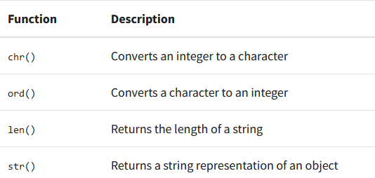
Character Code Conversion
ord(‘A’) 65 # Output
chr(65) A # Output

Slide 15
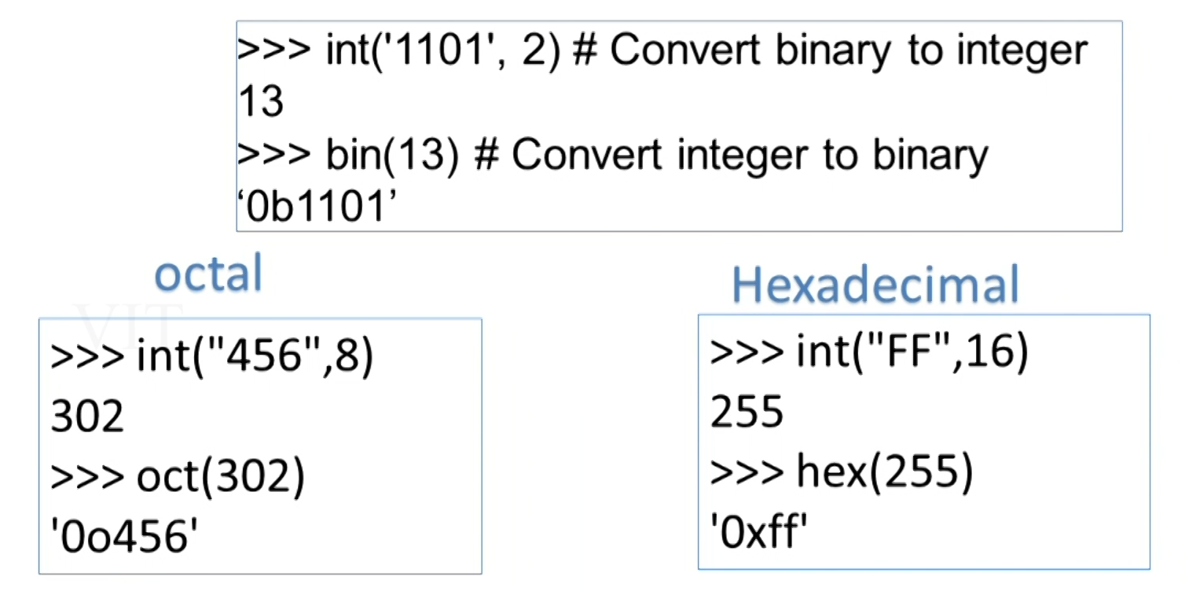
Number Conversion

Slide 16
String - Immutable
String – immutable
Immutable – you cannot change a string in place
Example:
S=‘Hello world”
S[2] = ‘h’ # Error
del S[3] # Error
S=“Welcome World” #Allowed, works fine

Slide 17
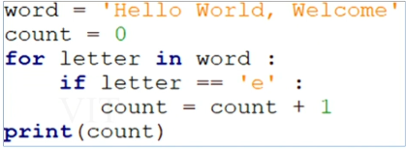
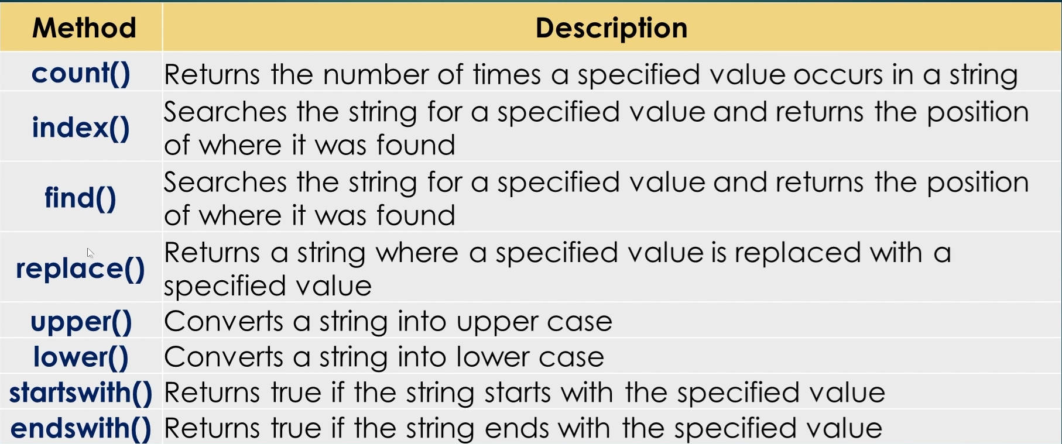
Strings: Sample Program
# Count the number of times character ‘e’ present in a given string

Slide 18
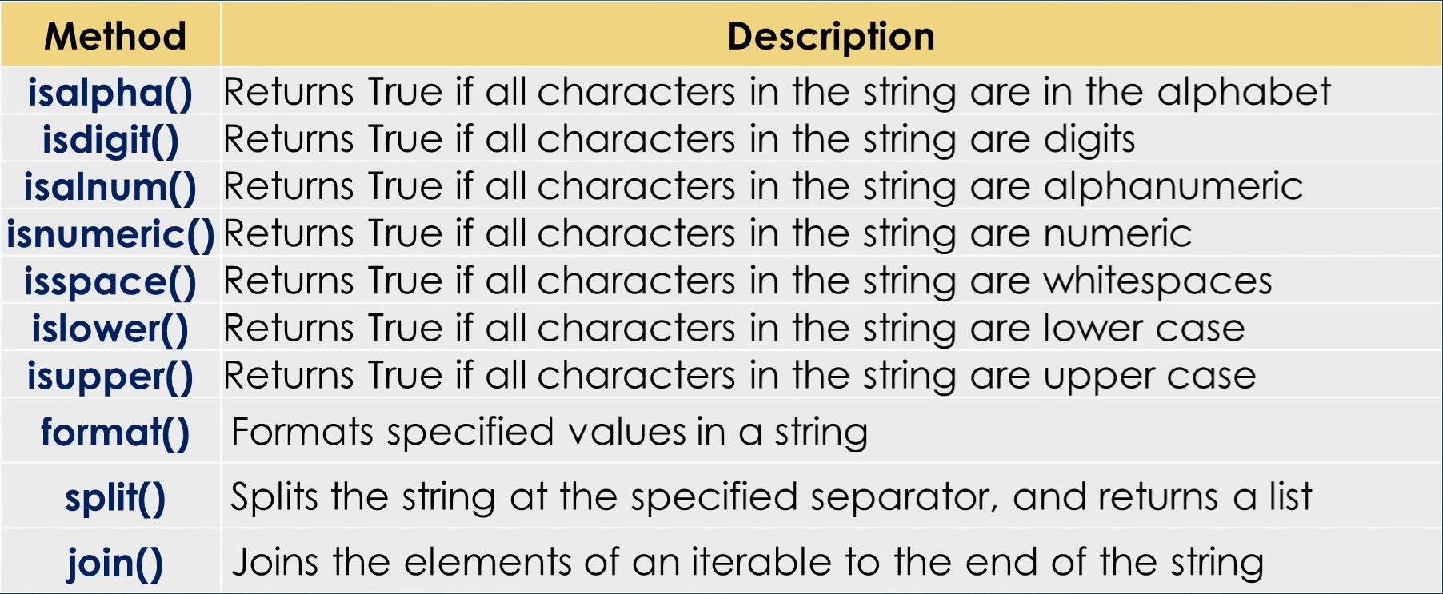
String Handling Functions

Slide 19
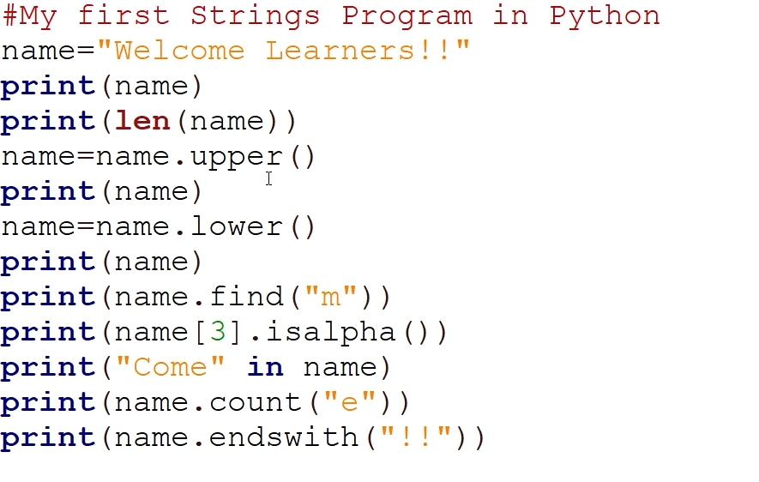
Sample Program

Slide 20
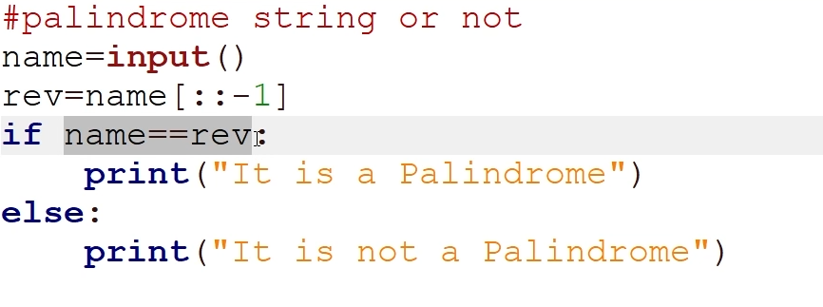
Sample Program
# To Check if the given string is Palindrome or not

Slide 21
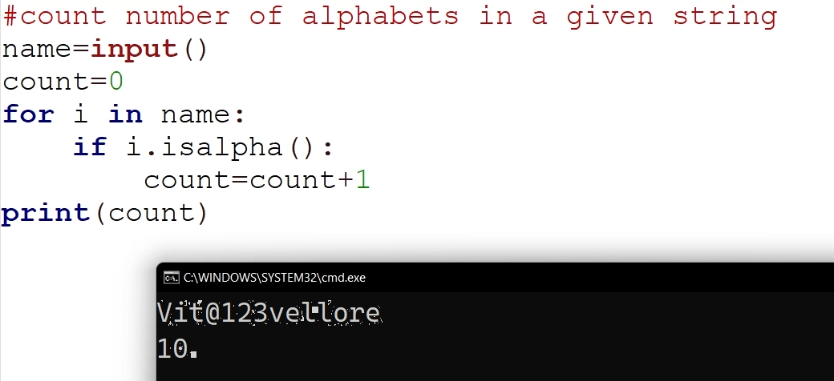
Sample Program
# To count the number of alphabets in a given string

Slide 22
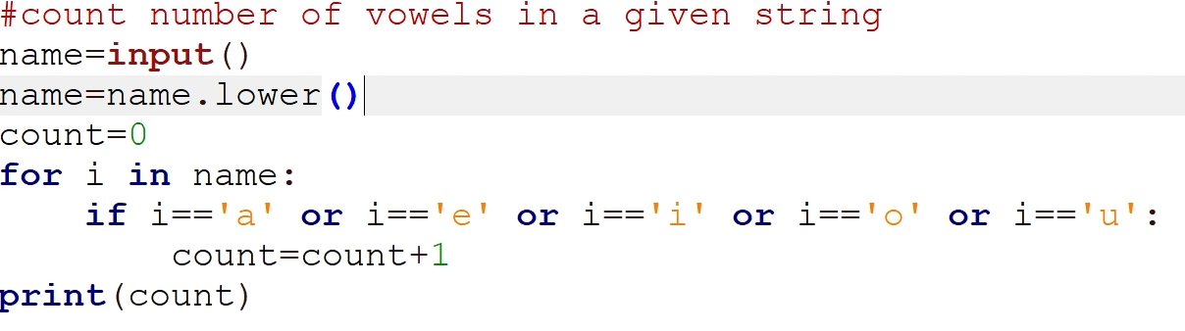
Sample Program
# To count the number of vowels in a given string

Slide 23
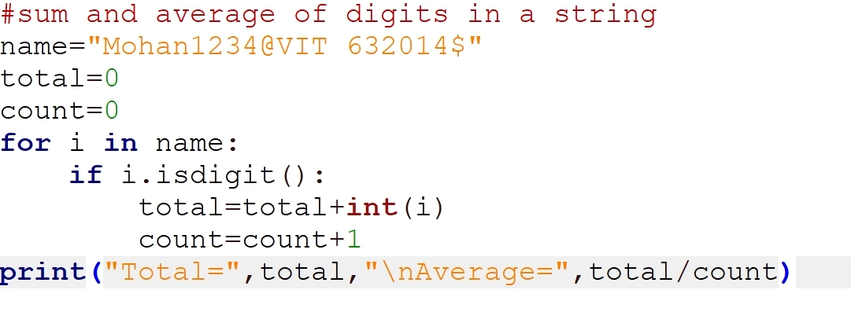
Sample Program
# To find sum and average of digit in a given string

Slide 24
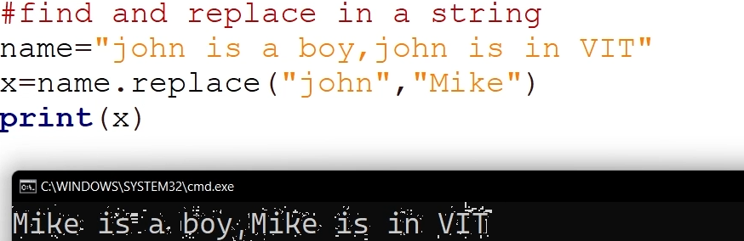
Sample Program
# Find and replace in a string

Slide 25
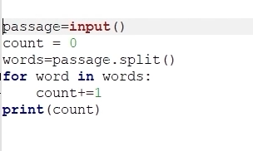
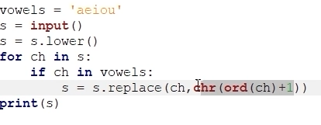
Sample Program
# Program to count the number of words in a string
# Program to replace vowels in a sentence with its next character

